Slide 1
Sprint #5 Presentation
Jamil Khan, Chaz Del Prato, Benjamin Seo, Christine Duong, Brandon Le, John Him

Slide 2
Updates
Management Plan
Gantt Chart
Burndown Chart
Project Tracking Matrix
Team Code Velocity
Sprint Retrospective

Slide 3
Sprint Goals
Create UI for Rating System to Rate Other Players
Connect Rating System to Database
Test Rating System
UI for Player Profile (Interests, Location, etc.)
Database Profile Editing
Test Profile Editing
Database for Creating Events
UI for Create an Event
Testing Create Event

Slide 4
Sprint Goals (continued)
UI for Join an Event
Database for Joining Events
Testing Join Event
Create/Modify ML Data Set
Create/Modify a Model
Testing Model Using DataSet

Slide 5
User Stories for This Sprint
Management Team:
As a management team, we want to be constantly learning and improving our Machine Learning model within our application.

Slide 6
User Stories for This Sprint
Player:
As a player, I would like to be able to rate other players, so that I can enjoy each players sportsmanship.
As a player, I want to be able to edit a profile that shows my age, skill level, and interested sports, so that I get notified when a related game is started.
As a player, I want to be able to create an event, so that I can start a pick-up game
As a player, I want to be able to join an event, so that I can join a pick-up game

Slide 7
APIs and Servers
APIs
Machine Learning Kit on Firebase.
Google Sign In/Sign Up
Modules (Grid, Bootstrap, etc.)
Etc.
Servers
We using Firebase Hosting, so we are serverless at this point.

Slide 8
APIs and Servers
External 3rd Party APIs:
Google Sign in/ Sign up
Data Extracted from 3rd Party APIs:
Account Sign in/Sign up Credentials

Slide 9
Type of ORM, ODM Libraries or Drivers Used in the Connection of Database to Server
JSData
JSData converts data from JavaScript Objects to formats used by MySQL, MongoDB, RethinkDB, Firebase, etc. and vice versa

Slide 10
Features in Data Sample
How many features are there in a data sample?
Type_Sport, Gender, Skill_Level, Last_Month_games, Last_3m_avg_games, Players_Rating
What is the source of the training data?
A website called Kaggle:
https://www.kaggle.com/shirantha/bank-marketing-data-a-decision-tree-approach
Thinking about what features correlate to what we want to recommend.
Did the team plot the data correlation between features and the label? What business relationship between features and labels that you can tell?
Since we do not have our datasets yet, we cannot plot them. However the correlations between the features and the label are similar enough that we are able to use them.

Slide 11
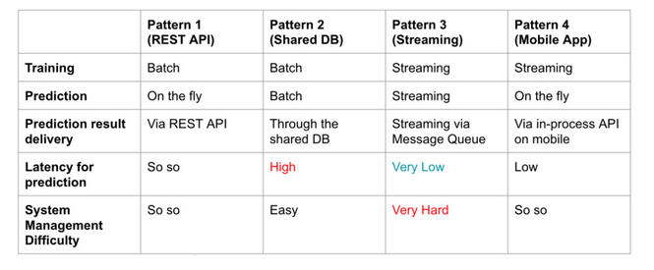
Machine Learning Deployment
How do we plan to deploy the machine learning model?
At the moment, we are planning on deploying our model as a Web API.
Alternative deployment architectures?
REST API = Web API

Slide 12
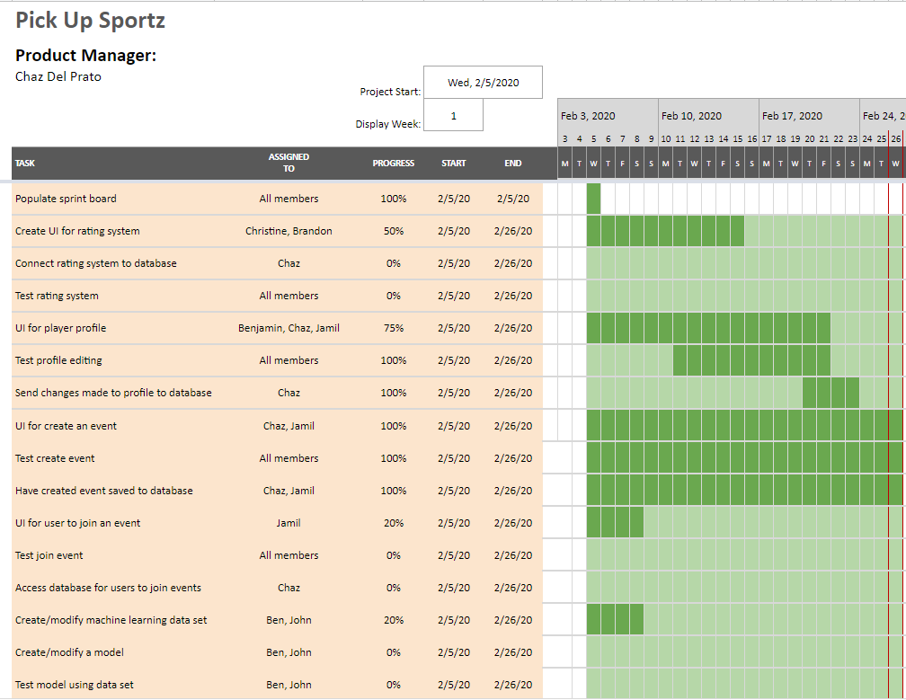
Gantt Chart

Slide 13
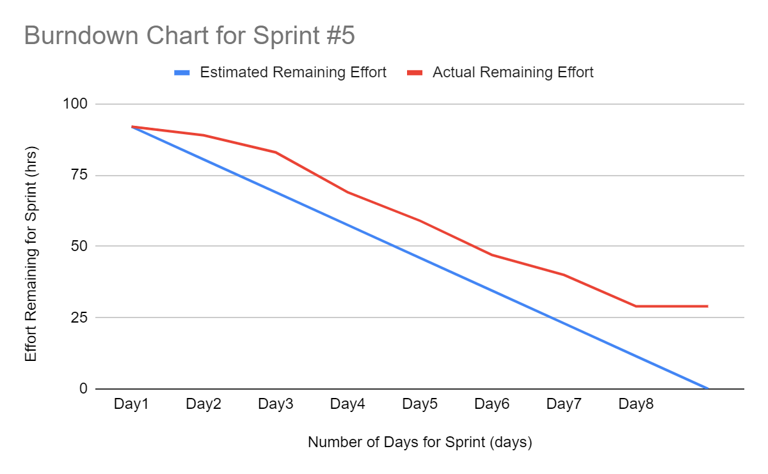
Burndown Curve

Slide 14
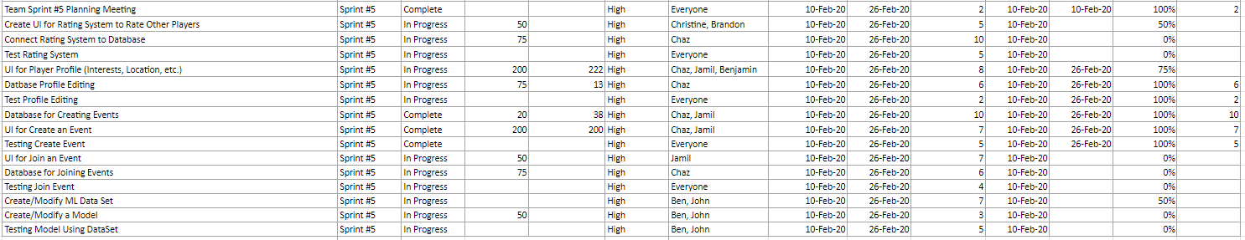
Project Planning Matrix

Slide 15
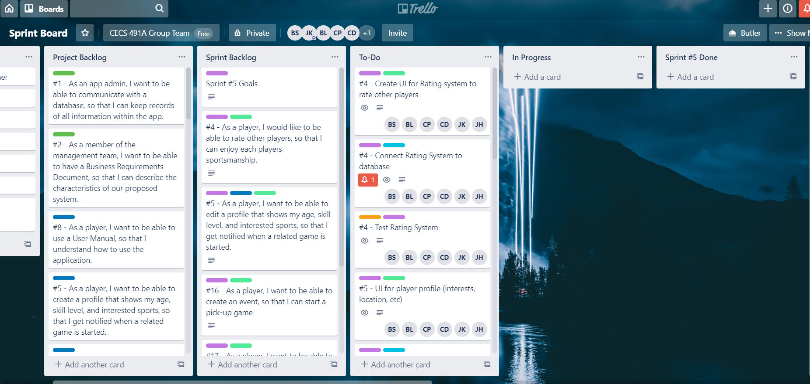
Sprint Board (Start)

Slide 16
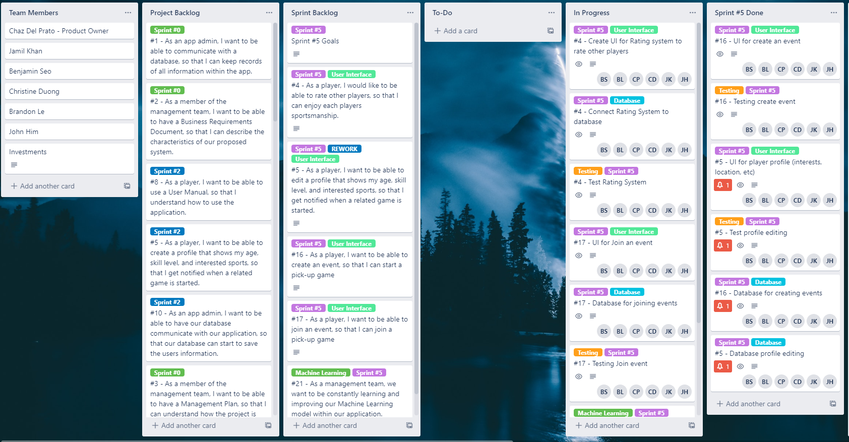
Sprint Board (End)

Slide 17
User Features
How many total user features?
Create account and log in/out
Create an event
Create Profile
Other features in progress
User rating system
Edit Profile Page UI
Ability to join an event

Slide 18
Sprint Retrospective
Our goal was to:
Create UI for Rating System to Rate Other Players
Connect Rating System to Database
Test Rating System
UI for Player Profile (Interests, Location, etc.)
Database Profile Editing
Test Profile Editing
Database for Creating Events
UI for Create an Event
Testing Create Event

Slide 19
Sprint Retrospective
Our goal was to:
UI for Join an Event
Database for Joining Events
Testing Join Event
Create/Modify ML Data Set
Create/Modify a Model
Testing Model Using DataSet

Slide 20
Sprint Retrospective
Our team’s total velocity is :
5 hours x 3 weeks x 6 members = 90 hours (story points).
We were not able to meet our sprint goal.
Overplanned.
Misjudged time availability.
Busy with other work.
A lot of problems came up when dealing with module compatibility.

Slide 21
Sprint Retrospective
What we did not finish:
Create UI for Rating System to Rate Other Players
Connect Rating System to Database
Test Rating System
UI for Player Profile (Interests, Location, etc.) - Page Layout

Slide 22
Sprint Retrospective
What we did not finished:
UI for Join an Event
Database for Joining Events
Testing Join Event
Create/Modify ML Data Set
Create/Modify a Model
Testing Model Using DataSet

Slide 23
Sprint Retrospective
Current hours worked:
24 hours completed on finished tasks.
45 + hours currently worked overall for both unfinished and finished tasks.
Burndown Chart Analysis:
We were not able to meet our sprint goals due to availability and overestimating the tasks that we had planned this sprint. We ended up spreading ourselves thin and made all around progress but unable to accomplish many goals we had for the sprint.

Slide 24
Sprint Retrospective
Team velocity for next sprint:
Keep the same team velocity to 90 hours.
Complete everything we were working on in sprint #5
No new tasks for next sprint.

Slide 25
Code Evaluation
User Stories Implemented
For Sprint #5, we implemented:
Users can login with google or their own account.
Users can sign up with google or on their own email.
User can logout.
Users can create an event for a pick-up game
User can Create and Edit Profile (no UI for Profile Page; Backend)
Code Function
Create account with google or their own email.
Sign in with google or their own account.
Logout.
Create event.

Slide 26
Code Evaluation
Code Function
Create account with google or their own email.
Sign in with google or their own account.
Logout.
Create event.
Create/Edit Profile (no Profile Page; Backend)

Slide 27
Code Evaluation
Platform
Web Application for all devices that is connected to the Internet
User Manual
Not implemented in the current build.
Number of Clicks/Entries per User Benefits
1-5 Clicks

Slide 28
Code Evaluation
-Ities Requirement
Trying to implement:
Scalability.
Accessibility.
Maintainability.
Amiability.
etc.

Slide 29
Code Review
Updated account creation to actually save to the database.
https://pick-up-sportz-89c6e.firebaseapp.com/

